Slide 1
Double Pointers
Raihan Kabir
Computer Science and Engineering
University of Chittagong

Slide 2
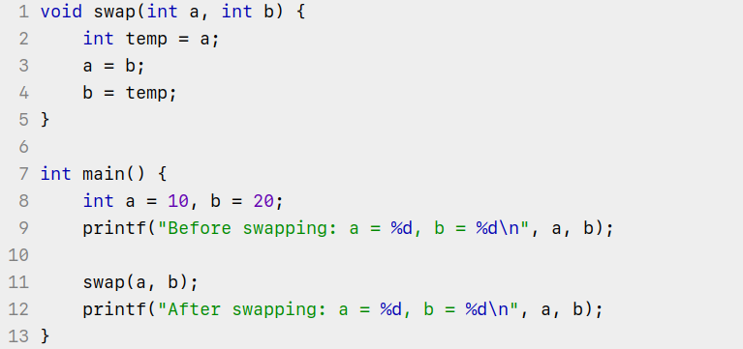
What will be the output?

Slide 3

What will be the output?
Output:

Slide 4
Why it didn’t change?
Because we are changing the local variable inside the function argument, not the actual variables that were inside the main function.

Slide 5
Why it didn’t change?
temp
temp = 10
b = 20
b = 10
swap
a = 10
swap
a = 20
b = 20
b = 20
main
a = 10
main
a = 10
After calling swap function
After executing swap function

Slide 6
Why it didn’t change?
temp = 10
popped
b = 10
popped
Swap popped
a = 20
popped
b = 20
main
a = 10
After returning to main function

Slide 7
What is the solution?
Pass the addresses of the variables to the function, so that any changes made to the variables takes place directly inside the addresses.

Slide 8
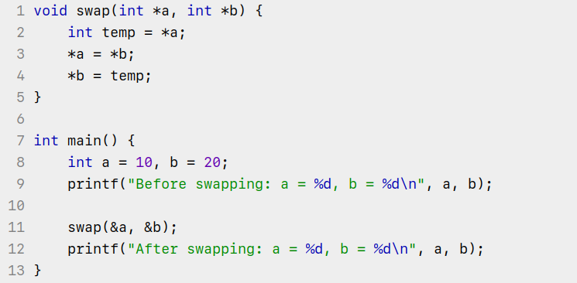
Solution

Slide 9

Solution
Output:

Slide 10
What happened?
temp
temp = *a (*0x100) = 10
b = &b (0x200)
b = &b (0x200)
swap
a = &a (0x100)
swap
a = &a (0x100)
b = 20
b = temp (*0x100) = 10
main
a = 10
main
a = *b (*0x200) = 20
After calling swap function
After executing swap function

Slide 11
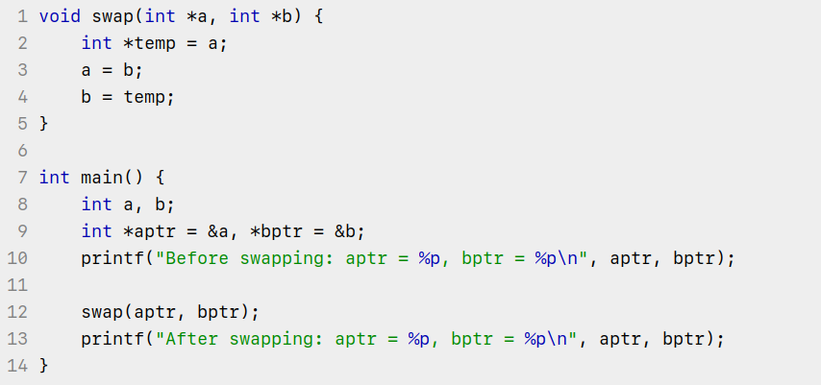
Now, say what will be the output?

Slide 12
Now, say what will be the output?

Slide 13
What happened?
temp
temp = a (aptr)
b = bptr
b = temp (aptr)
swap
a = aptr
swap
a = b (bptr)
bptr = &b
bptr = &b
main
aptr = &a
main
aptr = &a
After calling swap function
After executing swap function

Slide 14
What is the solution?
Same as before, but rather passing pointer to int, we will pass pointer to the pointer itself. Because we want to change the content of the pointer itself.

Slide 15
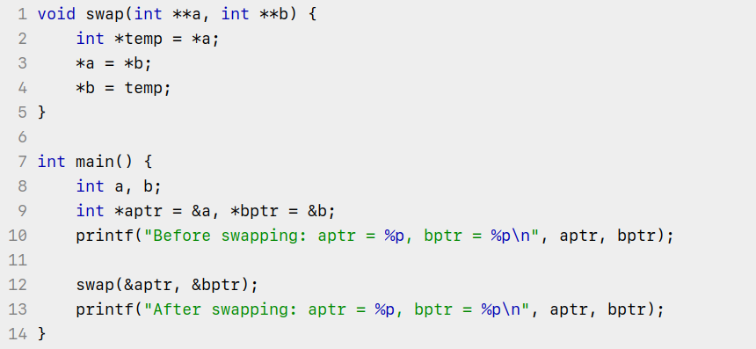
Solution

Slide 16
Solution

Slide 17
What happened?
temp
temp = *a (*&aptr)
b = &bptr
b = &bptr
swap
a = &aptr
swap
a = &aptr
bptr = &b
bptr = temp (*&aptr)
main
aptr = &a
main
aptr = *b (*&bptr)
After calling swap function
After executing swap function

Slide 18
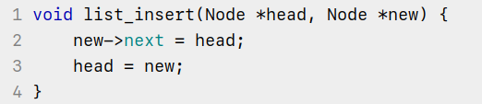
Now say, is below code logically correct?

Slide 19
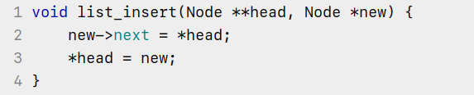
Correct solution

Slide 20
Summary
Use single pointer when you want to make changes to usual variables of a function within another function.
Use double pointers when you want to make changes to pointers of a function within another function.

Slide 21
The End

